Slide 1
Machine Learning Research
Nik Bear Brown
nik@ccs.neu.edu
Example Projects

Slide 2
Object Detection Mobile App for Visually Impaired

Slide 3
Applications of Computer Vision
1. Data Centers
Social Media Analysis
Govt. Intelligence
2. Gadgets
Self Driving cars
Smart phones
Drones

Slide 4
Applications of Computer Vision
1. Data Centers
Social Media Analysis
Govt. Intelligence
2. Gadgets
Self Driving cars
Smart phones
Drones
Low Power is required !!
Real time is required !!

Slide 5


Major Objectives
Object detection with a sufficiently high accuracy
Decreasing the size and power consumption
Calculating the distance from the object

Slide 6
Evaluation metrics:
Accuracy
Number of parameters
Size of the model

Slide 7
Current models
Year | Model | Top 1% accuracy | # Parameters
2012 | Alexnet | 57% | 62,378,344
2014 | GoogleLeNet | 68% | 102,897,440
2014 | VGG-16 | 71% | 138,357,544
2015 | ResNet-50 | 75% | 25,636,712
2016 | Inception-v3 | 78% | 23,851,784

Slide 8
Problem at hand
Reduce the number of parameters keeping a decent accuracy
Because…
# Parameters ∝ Size of the model ∝ Power consumption

Slide 9
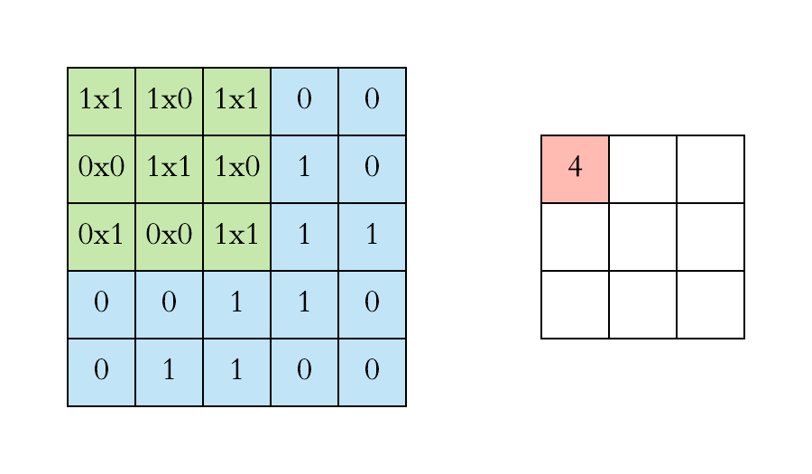
A Regular CNN

Slide 10
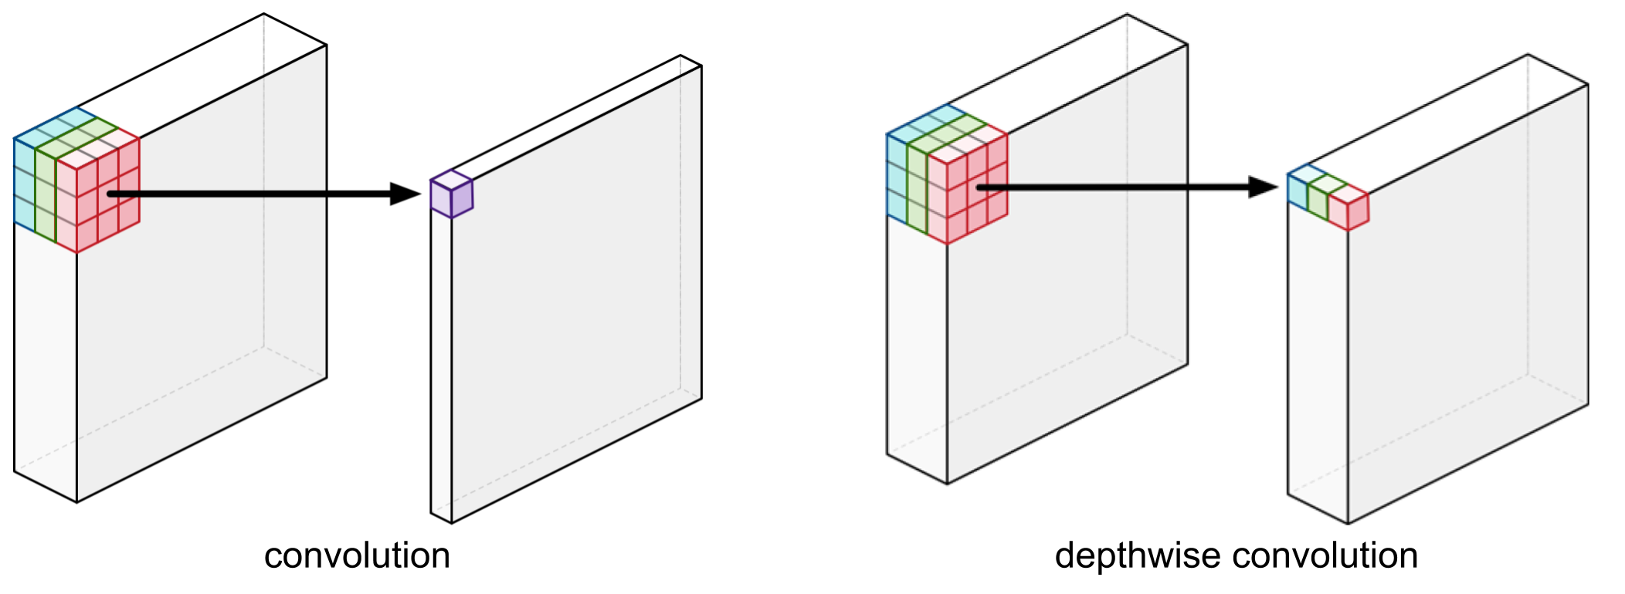
Our Approach
Depth-wise Convolution (Xception: Deep Learning with Depthwise Separable Convolutions)
Notes:
Instead of applying filters to all the channels, it applied filter to some of the channels. Usually doesn’t kill the accuracy.

Slide 11
Why do this?
A regular convolution has to do much more computational work to get there and needs to learn more weights.
Depth-wise Separable Convolution is about 9 times as fast as the regular convolution!

Slide 12
Initial model’s demo
Top-1% Accuracy = 70.6%
Number of parameters = 4,253,864
FPS = ?

Slide 13
Can we make it even better?

Slide 14
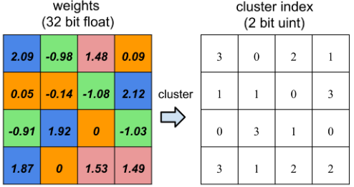
Things we looked at:
Quantization (Fixed Point Quantization of Deep Convolutional Networks)

Slide 15
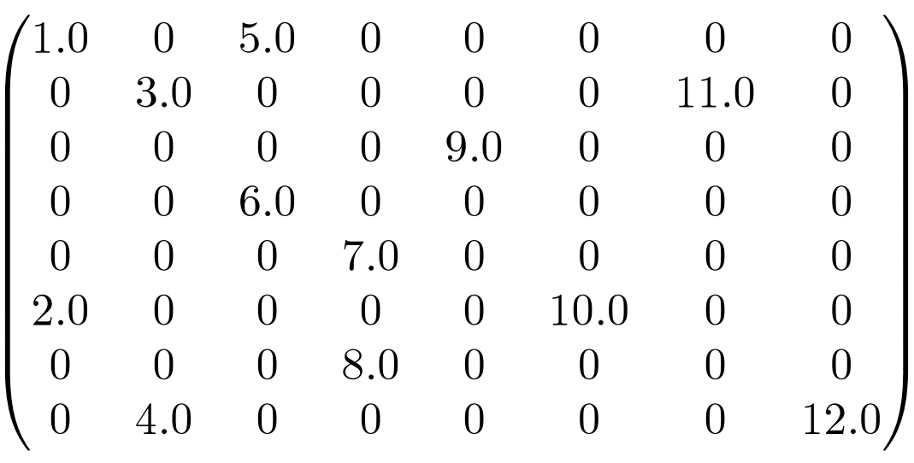
Things we looked at:
Setting low weights to ZERO (Two-Bit Networks for Deep Learning on Resource-Constrained Embedded Devices)
Notes:
Unfortunately, GPUs aren’t great at working with sparse matrices and you may lose more in computation time than you gained by shrinking the network. In this case, smaller does not necessarily mean faster. creates an additional storage overhead

Slide 16
Other techniques
Most Pruning techniques try to remove parameters from the fully connected layers because of its density.
But…
The fully connected layers of VGG-16 occupy 90% of the total parameters but only contribute less than 1% of the overall floating point operations (FLOP).

Slide 17
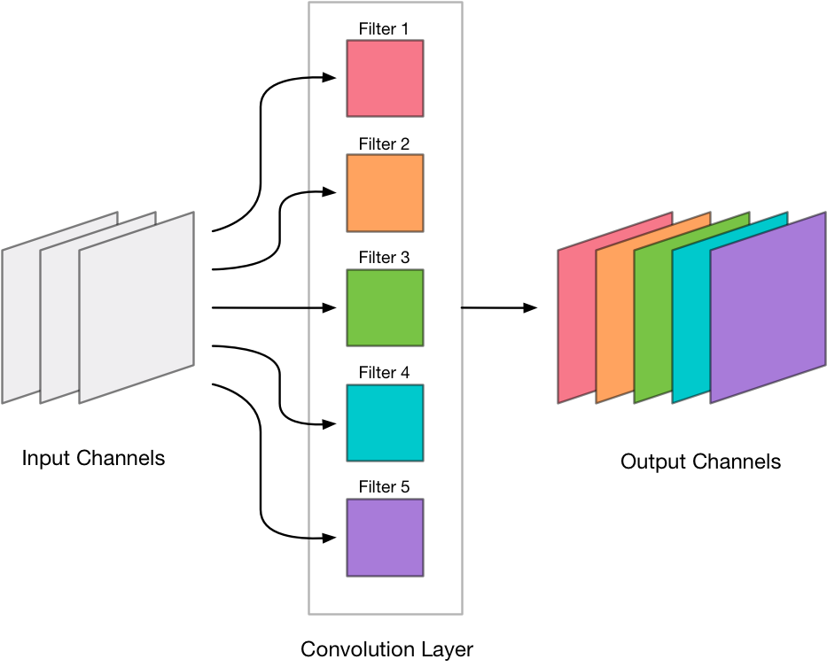
Our Solution
Filter Pruning (PRUNING FILTERS FOR EFFICIENT CONVNETS )

Slide 18
Issues
Depth-wise layer cannot be reduced using filter pruning
Computational and Storage issues for using image-net data (300 GB)

Slide 19
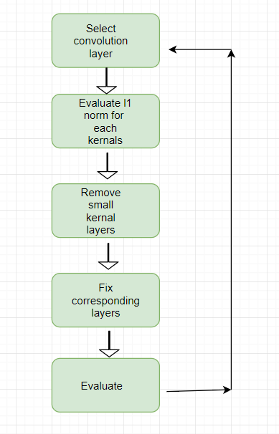
Workflow

Slide 20
Convolution Layers
Layer (type) | Original Output Shape | Original Params | Pruned Output Shape | Pruned Params
conv1 (Conv2D) | (, 112, 112, 32) | 864 | (, 112, 112, 32) | 0
conv_pw_1 (Conv2D) | (, 112, 112, 64) | 2048 | (, 112, 112, 64) | 0
conv_pw_2 (Conv2D) | (, 56, 56, 128) | 8192 | (, 56, 56, 128) | 0
conv_pw_3 (Conv2D) | (, 56, 56, 128) | 16384 | (, 56, 56, 128) | 0
conv_pw_4 (Conv2D) | (, 28, 28, 256) | 32768 | (, 28, 28, 256) | 0
conv_pw_5 (Conv2D) | (, 28, 28, 256) | 65536 | (, 28, 28, 256) | 0
conv_pw_6 (Conv2D) | (, 14, 14, 512) | 131072 | (, 14, 14, 512) | 0
conv_pw_7 (Conv2D) | (, 14, 14, 512) | 262144 | (, 14, 14, 512) | 0
conv_pw_8 (Conv2D) | (, 14, 14, 512) | 262144 | (, 14, 14, 512) | 0
conv_pw_9 (Conv2D) | (, 14, 14, 512) | 262144 | (, 14, 14, 512) | 0
conv_pw_10 (Conv2D) | (, 14, 14, 512) | 262144 | (, 14, 14, 512) | 0
conv_pw_11 (Conv2D) | (, 14, 14, 512) | 262144 | (, 14, 14, 512) | 0
conv_pw_12 (Conv2D) | (, 7, 7, 1024) | 524288 | (, 7, 7, 1024) | 0
conv_pw_13 (Conv2D) | (, 7, 7, 1024) | 1048576 | (, 7, 7, 704) | 400,256

Slide 21
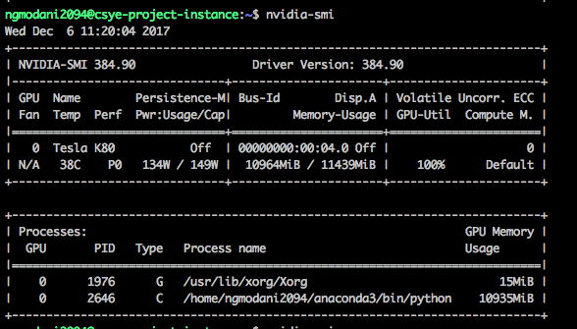
Hardware
Google Cloud Platform
8 Core CPU, 30 GB Memory
1 NVIDIA Tesla K80 GPU

Slide 22
Result
 | Original model | Pruned model (only last layer)
Accuracy | 70.6 | 68.12
No of parameters | 4,253,864 | 3,583,656 (84% of the original)
FPS | 0 to 1 | 10 to 15

Slide 23
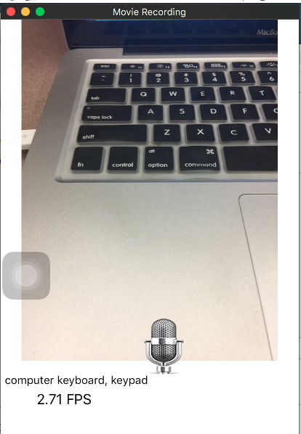
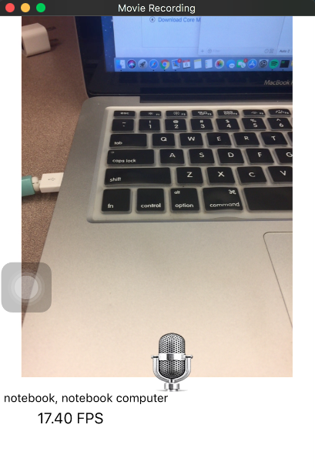

Slide 24
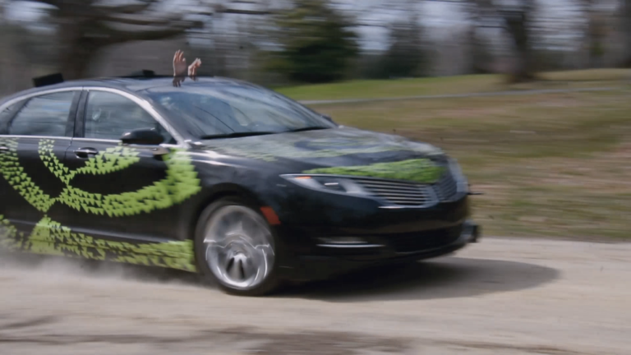
Self Driving Cars

Slide 25
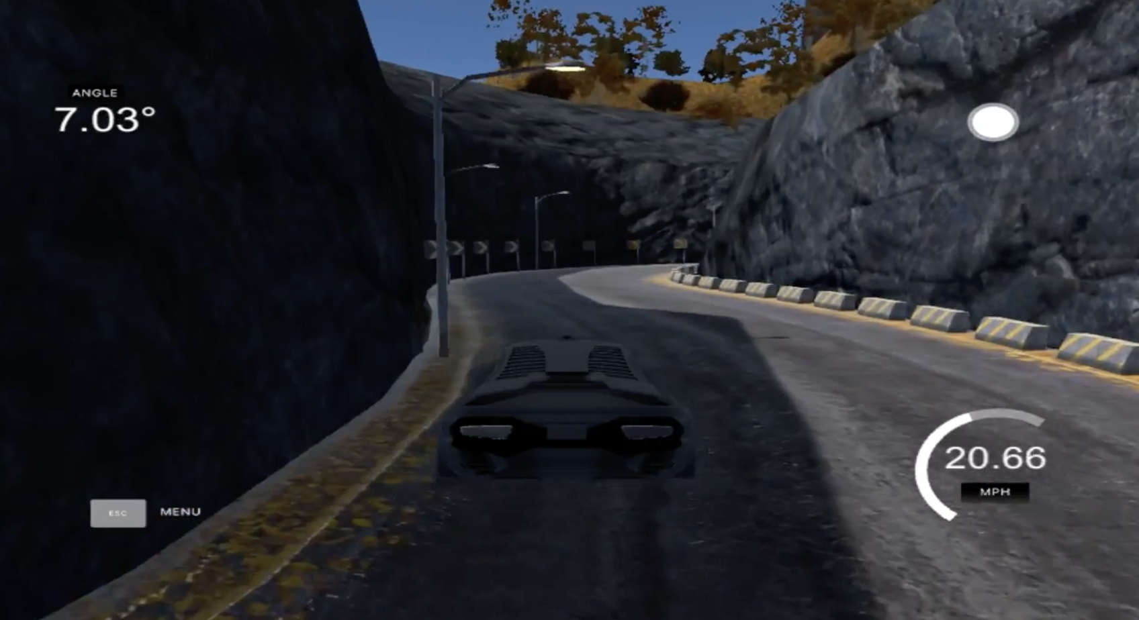
PROBLEM STATEMENT
Supervised regression problem between the car steering angles and the road images in front of a car
use a neural network to clone car driving behavior
https://www.youtube.com/watch?v=-zWhgLDXqyY

Slide 26
APPROACH
DATA GENERATION
TRAINING MODE
TESTING MODE
DATA PREPROCESSING

Slide 27
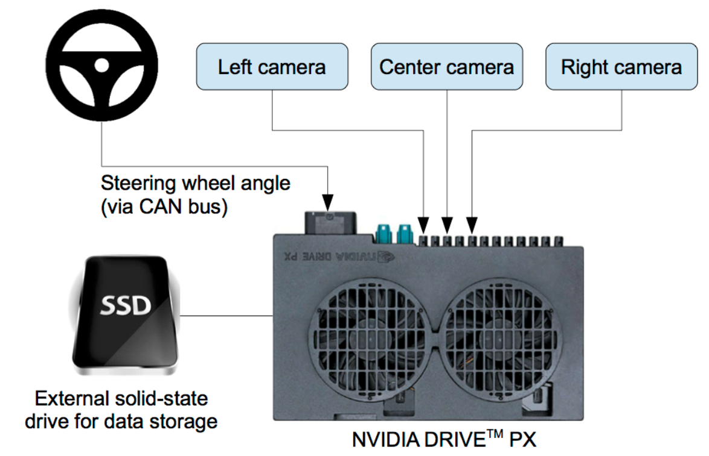
NVIDIA MODEL FOR DATA GENERATION

Slide 28
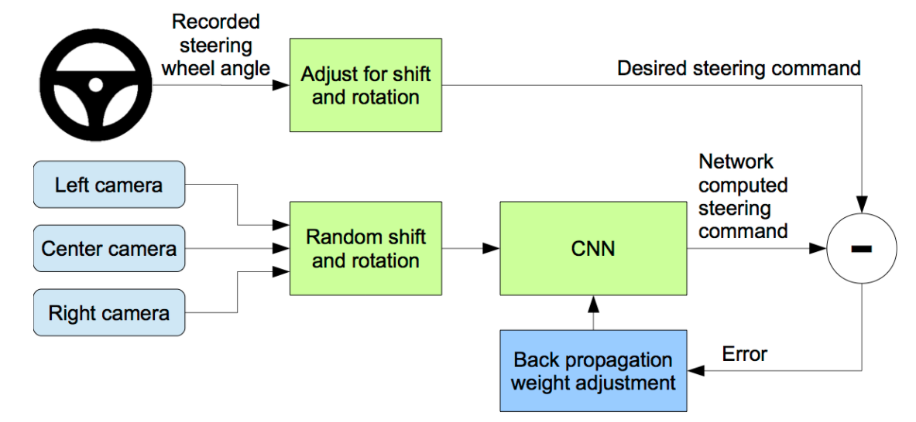
Software Design

Slide 29
Reference
[1] Y. LeCun, B. Boser, J. S. Denker, D. Henderson, R. E. Howard, W. Hubbard, and L. D. Jackel. Backpropagation applied to handwritten zip code recognition. Neural Computation, 1(4):541–551, Winter 1989. URL: http://yann.lecun.org/exdb/publis/pdf/lecun-89e.pdf.
[2] Alex Krizhevsky, Ilya Sutskever, and Geoffrey E. Hinton. Imagenet classification with deep convolutional neural networks. In F. Pereira, C. J. C. Burges, L. Bottou, and K. Q. Weinberger, editors, Advances in Neural Information Processing Systems 25, pages 1097–1105. Curran Associates, Inc., 2012. URL: http://papers.nips.cc/paper/ 4824-imagenet-classification-with-deep-convolutional-neural-networks. pdf.
[3] L. D. Jackel, D. Sharman, Stenard C. E., Strom B. I., , and D Zuckert. Optical character recognition for self-service banking. AT&T Technical Journal, 74(1):16–24, 1995.
[4] Large scale visual recognition challenge (ILSVRC). URL: http://www.image-net.org/ challenges/LSVRC/.
[5] Net-Scale Technologies, Inc. Autonomous off-road vehicle control using end-to-end learning, July 2004. Final technical report. URL: http://net-scale.com/doc/net-scale-dave-report.pdf. [
6] Dean A. Pomerleau. ALVINN, an autonomous land vehicle in a neural network. Technical report, Carnegie Mellon University, 1989. URL: http://repository.cmu.edu/cgi/viewcontent. cgi?article=2874&context=compsci.

Slide 30

Eugene Cheah | Mahalakshmi Arunachalam
INFO 7390 Advances in Data Sciences and Architecture
Uber Data Optimization

Slide 31
Abstract
Being an Uber driver may sound lucrative, but how real is it and can the time utilization be
maximized as they also need to pay for expenses for running the car or its insurance. An Uber
driver may happen to be driving at a particular location, but there is no guarantee that there are
passengers there, if any. Logically speaking, it is better to have accurate predictions for an Uber
driver to decide upon his/her own schedule, maximize earnings in a shorter time, and on top of
that knowing all the best driving locations where ride-hailing customers are densest. Conducting
data analysis, training predictive models, and building an application would come in handy for
the drivers, all in which are the aim of the project.

Slide 32
Introduction
The purpose of the research would be to build an application to optimize Uber drivers’ rides in
Boston. With this application Uber drivers should have a higher driving frequency, leading to
higher profit margins in less time. Factors and assumptions to take into consideration include but
are not limited to customer pickup frequency, time of day, weather, and popular events
happening in the city. Through this project, we aim to learn and apply predictive models like
time series analysis, as well as machine learning methods such as Support Vector Machines, K-
Nearest Neighbors, and Naïve Bayes. Uber drivers only have a finite amount time for driving, so
why not make the most out of their driving time?

Slide 33
Approach to Obtaining the Uber Dataset
Datasets Sources
Uber API - https://developer.uber.com/dashboard/
Uber Rides Python SDK (beta) - https://github.com/uber/rides-python-sdk
Yelp API - https://www.yelp.com/developers/documentation/v3/business_search

Slide 34
Approach to Obtaining the Uber Dataset
Steps to querying the Uber API:
register an application on Uber’s developer dashboard
install the uber-rides SDK
Create an Uber session with a server token
Set a pair of coordinates to return Uber data on its services and price estimates

Slide 35
Approach to Obtaining the Uber Dataset
Steps to parameterize location in Boston and Cambridge:
Query Yelp’s API
Specify a term, such as food, to return a list of businesses based on a set of zip codes in the Boston and Cambridge area
Write a script to append Uber data based on returned Yelp businesses’ coordinates
Automate the process by performing a Cron Job

Slide 36
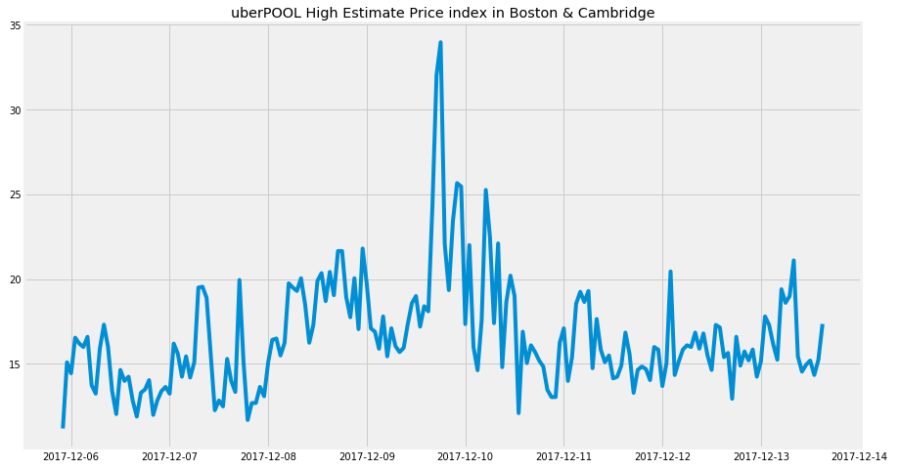
Time series analysis
uberPOOL’s high price estimates spiked on 9th of December due to snow

Slide 37
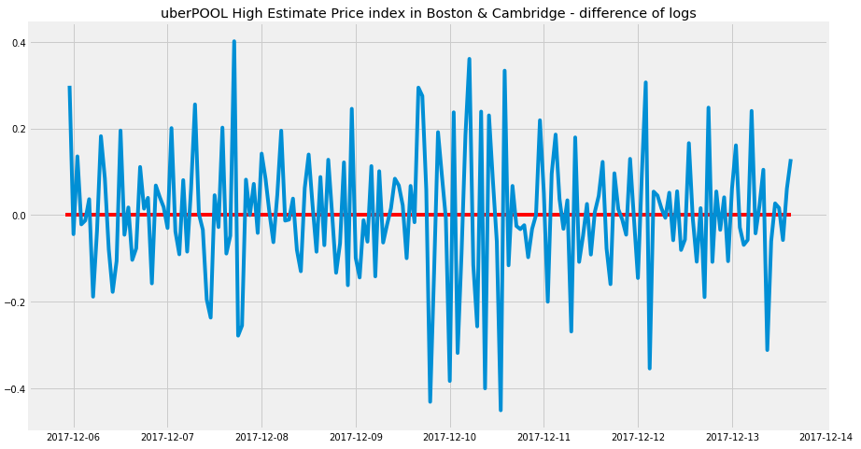
Time series analysis
A plot of difference of uberPOOL’s high price estimate logs.

Slide 38
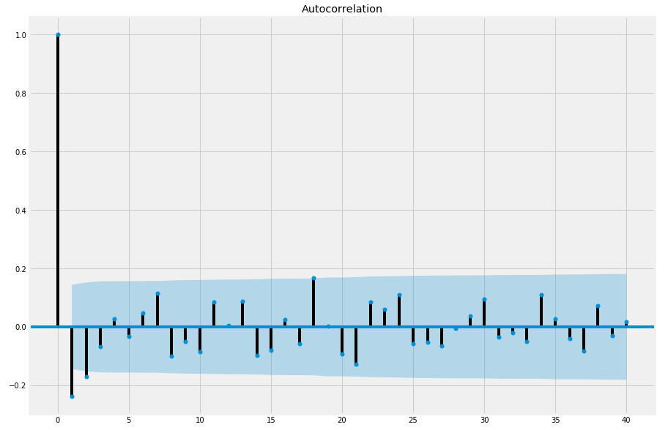
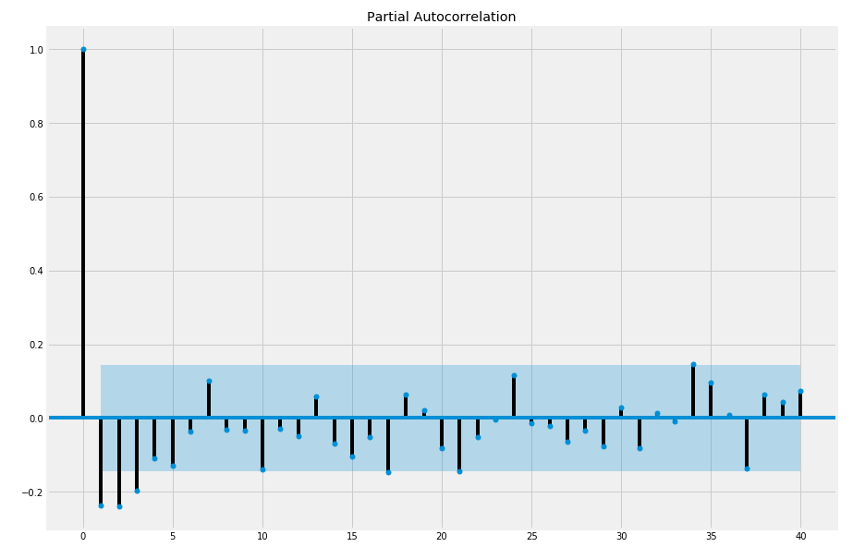
Time series analysis
Plots showing autocorrelation and partial autocorrelation function on high price estimates with a lag of 40
They indicate a higher order autoregressive term in the data and thus an AR(1 model) would be feasible

Slide 39
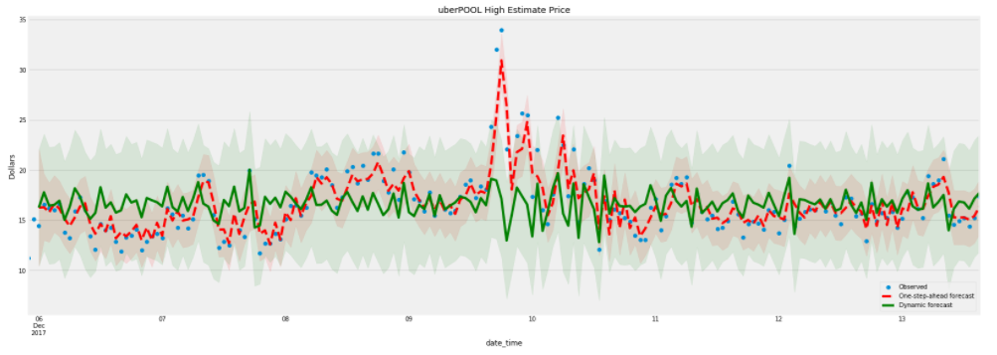
Time series analysis
The plot shows observed price estimates data, one-step-ahead forecast, and dynamic forecast
The one-step ahead forecast works better than the dynamic forecast, which makes sense since Uber constantly updates its price estimates by the minute

Slide 40
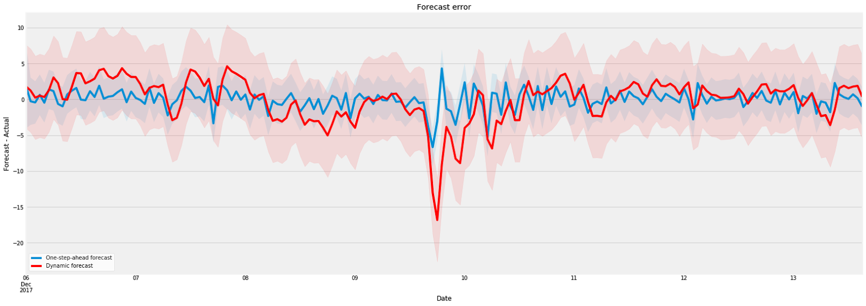
Time series analysis
The plot shows a graph matching up forecast errors between one-step-ahead forecast and dynamic forecast
Dynamic forecast generally did poorly across all six ride types when the actual data has a sudden spike on the snowy day of December, whereas one-step-ahead forecast manages to forecast with less discrepancy.

Slide 41
supervised Learning Employed
Support Vector Machines
K-Nearest Neighbors
Naïve Bayes

Slide 42
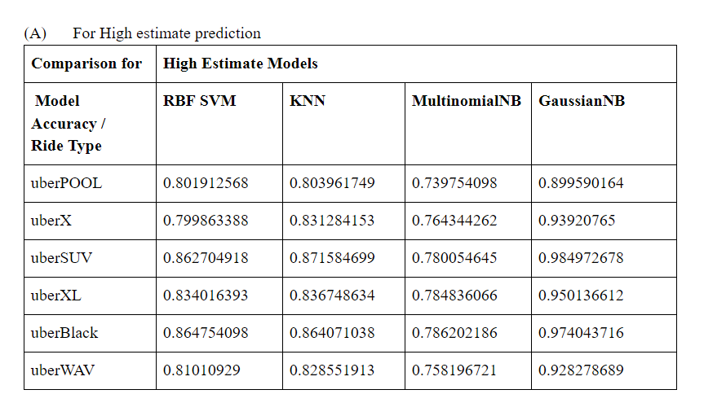
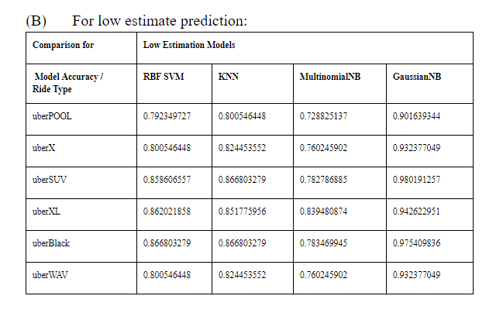
Supervised Learning Result Analysis
Based on the values, the Gaussian Naïve Bayes is the best model amongst the four models compared in the project
K – nearest neighbors is second best, followed by RBF SVM and Multinomial Naïve Bayes.

Slide 43
List of qualifiers used for best method prediction in confusion matrix
Accuracy: Overall, how often is the classifier correct?
(TP+TN)/total
Misclassification Rate: Overall, how often is it wrong?
(FP+FN)/total
equivalent to 1 minus Accuracy
also known as "Error Rate"
True Positive Rate: When it's actually yes, how often does it predict yes?
TP/actual yes
also known as "Sensitivity" or "Recall"
False Positive Rate: When it's actually no, how often does it predict yes?
FP/actual no
Specificity: When it's actually no, how often does it predict no?
TN/actual no
equivalent to 1 minus False Positive Rate
Precision: When it predicts yes, how often is it correct?
TP/predicted yes
Prevalence: How often does the yes condition actually occur in our sample?
actual yes/total

Slide 44
List of qualifiers used for best method prediction in classification report:
The precision is the ratio tp / (tp + fp) where tp is the number of true positives and fp the number of false positives. The precision is intuitively the ability of the classifier not to label as positive a sample that is negative.
The recall is the ratio tp / (tp + fn) where tp is the number of true positives and fn the number of false negatives. The recall is intuitively the ability of the classifier to find all the positive samples.
The F-beta score can be interpreted as a weighted harmonic mean of the precision and recall, where an F-beta score reaches its best value at 1 and worst score at 0..
The support is the number of occurrences of each class in which is truth (correct) target values.

Slide 45
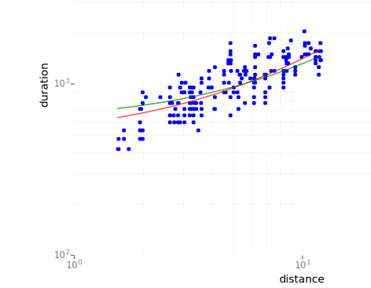
Trends observed
Fig: Duration v/s distance graph using linear regression.
the duration of the ride does play an important part and is seen linearly affecting the cost of the ride

Slide 46
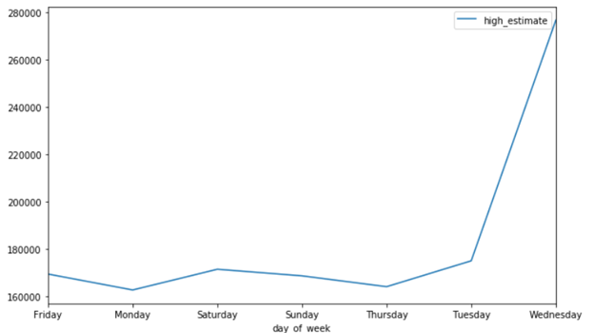
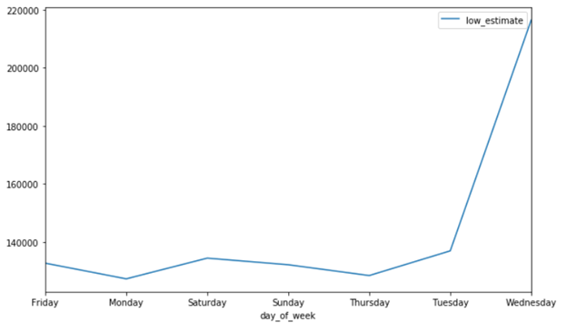
Trends observed
Fig: Plot of sum of high estimates (left) and low estimates (right) on weekdays
Mid week has the highest price estimates

Slide 47
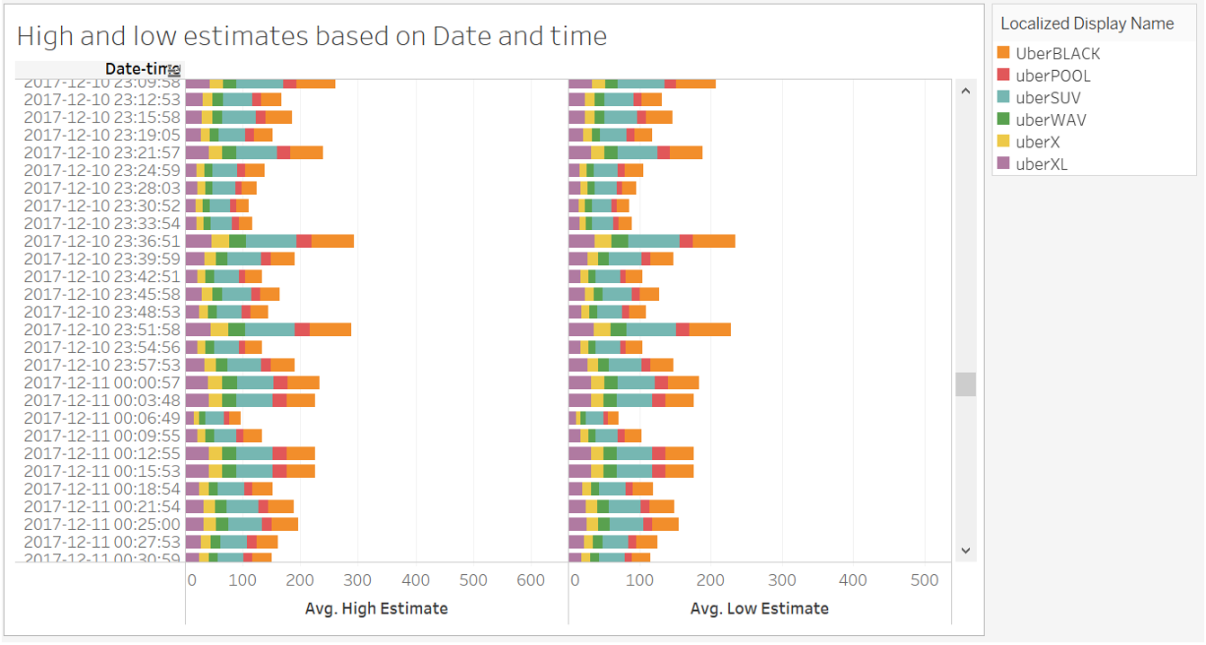
Trends observed
As depicted in the figure below, it is more profitable to be uberSUV and uberBLACK drivers, as their average estimates are greater than other rides.

Slide 48
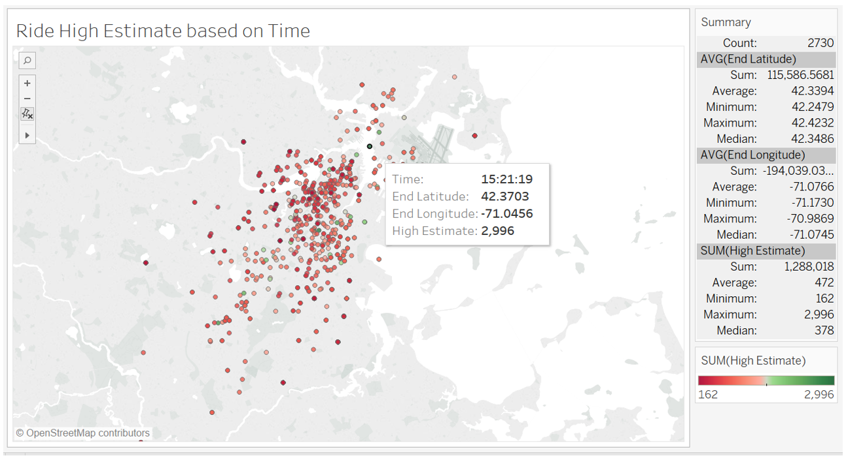
Trends observed
the figure shows early morning and midnight rides are more profitable.

Slide 49
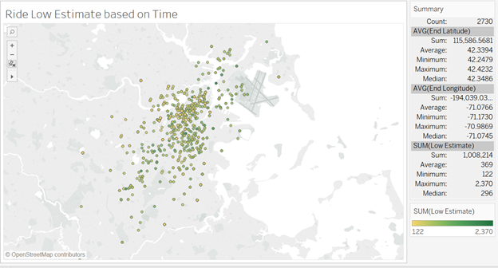
Trends observed
The figure shows that low price estimates follow the same trend as high price estimates trend

Slide 50
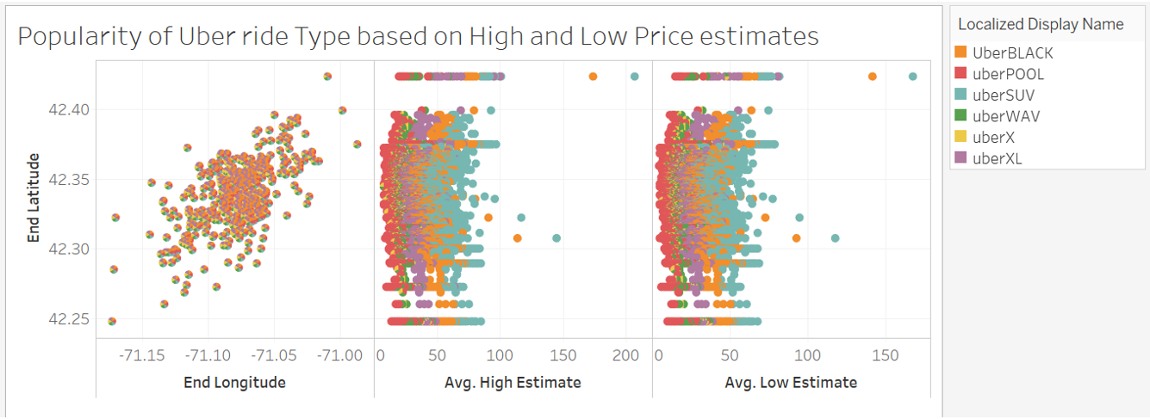
Trends observed
UberBLACK is the most popular ride but with profits lesser than uberSUV which has higher returns in price estimates but is not as popular

Slide 51
Music Generation using RBM and TensorFlow

Slide 52
Introduction
involves the generation of music by training the Restricted Boltzmann Machine model using RNN
Data is a set of homogeneous instrumental music to produce new music
The technique can give some appreciable results, but music is more complex than a series of strict rules
propose the use of a new machine learning model that has been specially designed to learn time sequence phenomenon

Slide 53
Motivation
The datasets in real life are much more complex
More challenging when the data is in an unstructured format such as image or audio
Having inspired by music and having decent understanding of music theory, we were motivated to work on this project
Music theory (sheets) – notes are related to each other.
These notes are just ways to mapping out pitches or sound waves

Slide 54
Audio Data
Directly or indirectly, we are always in contact with audio
simple example can be your conversations with people which you do daily
So, can you somehow catch this audio floating all around you to do something constructive?
Yes, of course! There are devices built which help you catch these sounds and represent it in computer readable format.
Examples of these formats are wav, mp3, wma, midi

Slide 55
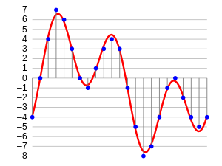
Audio wave

Slide 56
Musical Instrument Digital Interface (midi)
MIDI isn't music
MIDI doesn't contain any actual sounds
MIDI isn't a digital music file format like MP3 or WAV
MIDI is nothing more than data -- a set of instructions
MIDI data contains a list of events or messages that tell an electronic device (musical instrument, computer sound card, cell phone, et cetera) how to generate a certain sound

Slide 57
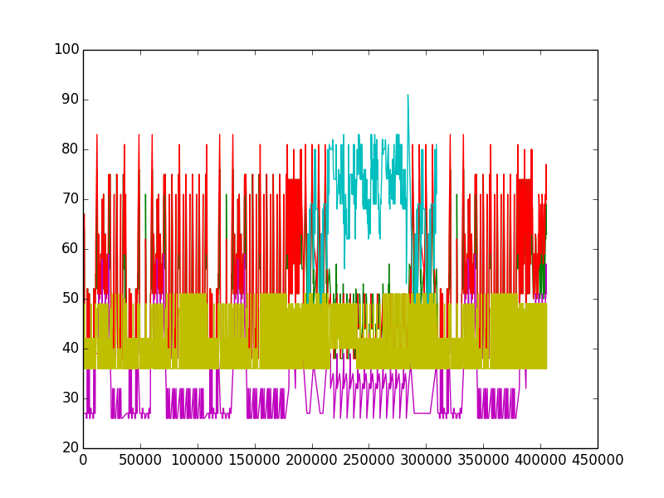

Slide 58
Train Data (.midi)
Our training data will be around a hundred MIDI files of pop songs (MIDI is a format that directly encodes musical notes)
To keep it simple, we won’t label them with emotions, our output will be another pop melody, just like our training files.

Slide 59
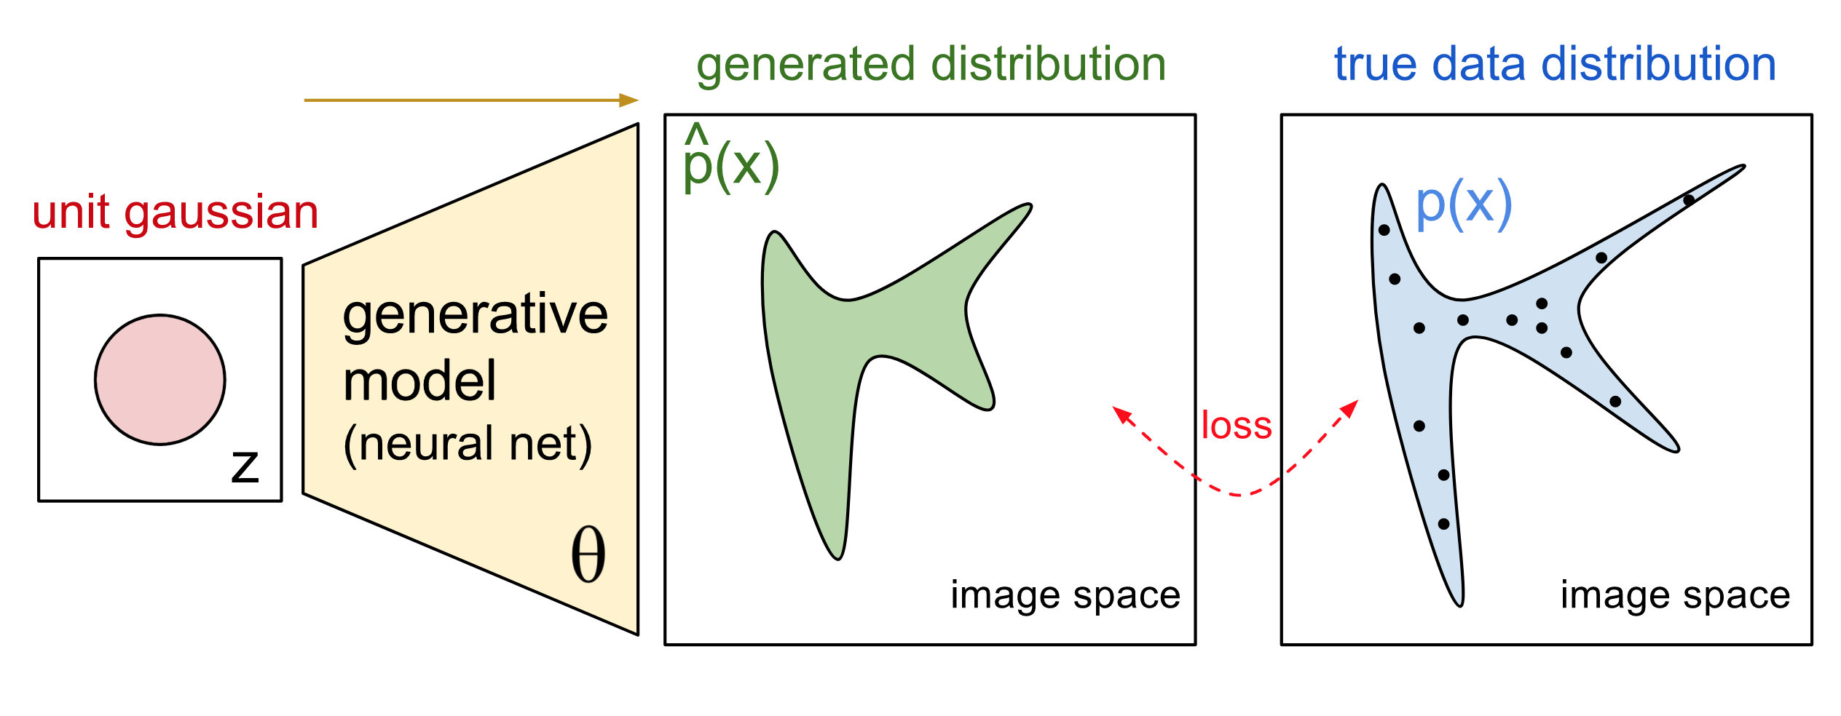
Generative Models
It is a model that allows us to learn simulator of data
An approach for unsupervised learning of data
Generative models are typically probabilistic, specifying a joint probability distribution over observation and target (label) values
Since, we are going to use a generative model, we can generate new samples directly by sampling from the modelled probability distribution

Slide 60
Sound from Recurrent Neural Networks
Audio generation seems like a natural application of recurrent neural networks, which are currently very popular (and effective) models for sequence-to-sequence learning
They have been used in speech recognition and speech synthesis

Slide 61
Restricted Boltzmann Machine
a generative stochastic artificial neural network that can learn a probability distribution over its set of inputs
RBMs are generative models that directly model the probability distribution of data

Slide 62
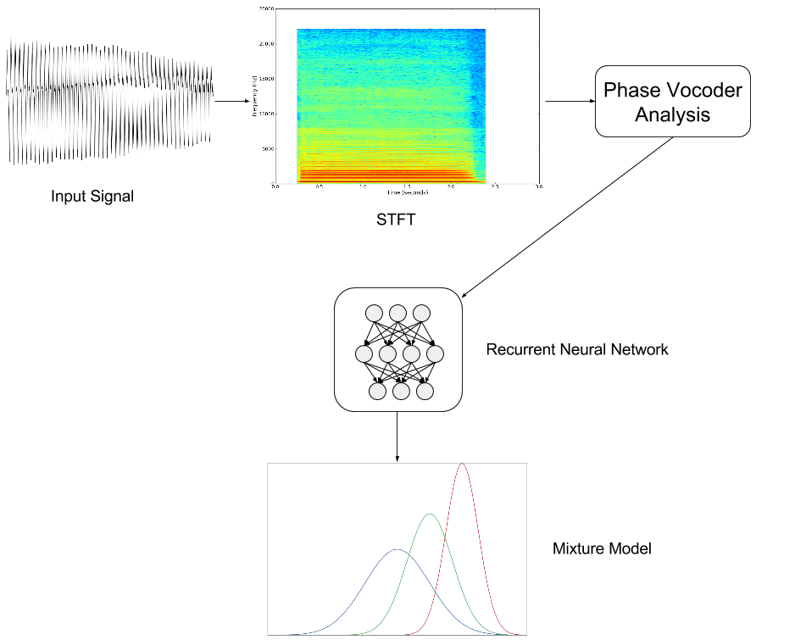

Slide 63

Python Libraries
TensorFlow™ is an open source software library for numerical computation using data flow graphs.
Nodes in the graph represent mathematical operations, while the graph edges represent the multidimensional data arrays (tensors)
communicated between them.

Slide 64
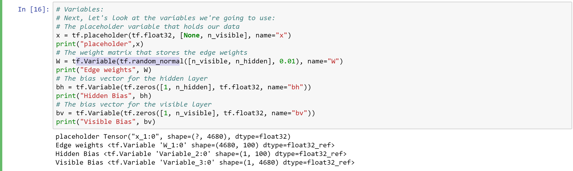
Initialising the parameters in TensorFlow

Slide 65
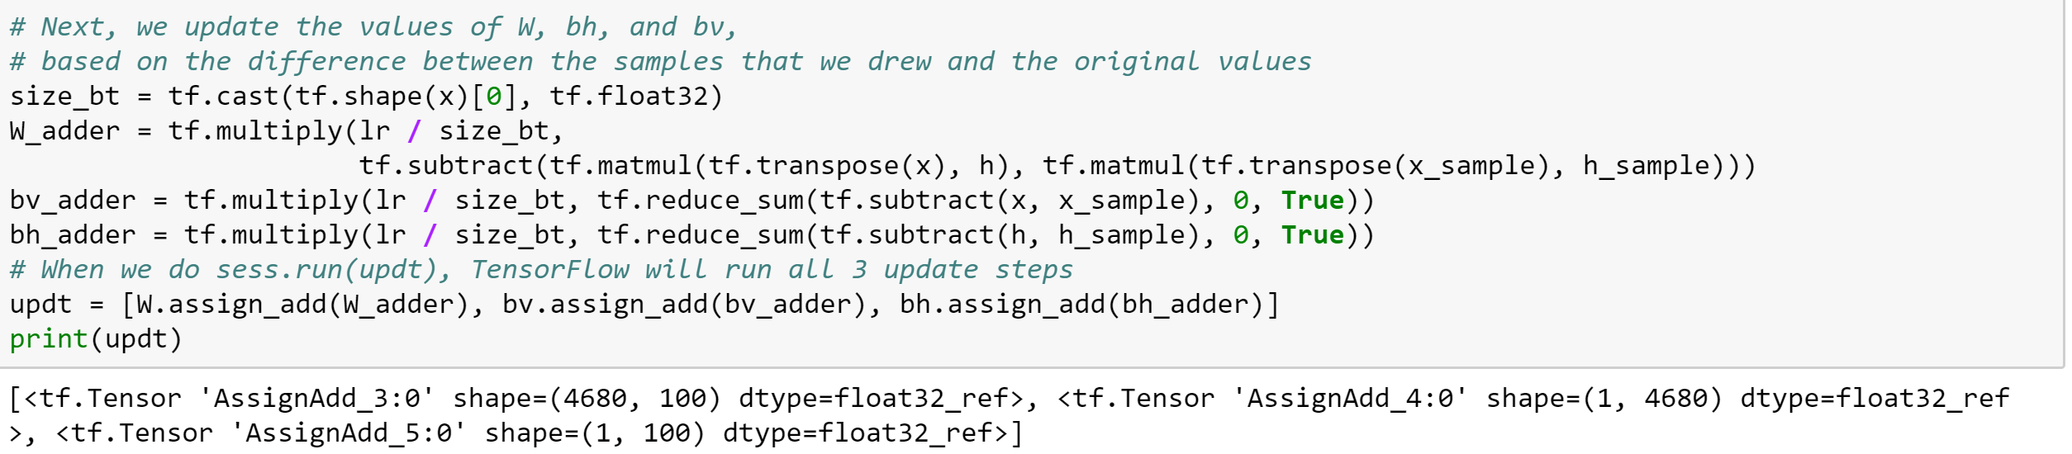
Updating the input parameters based on the difference between the samples that we drew and original values

Slide 66
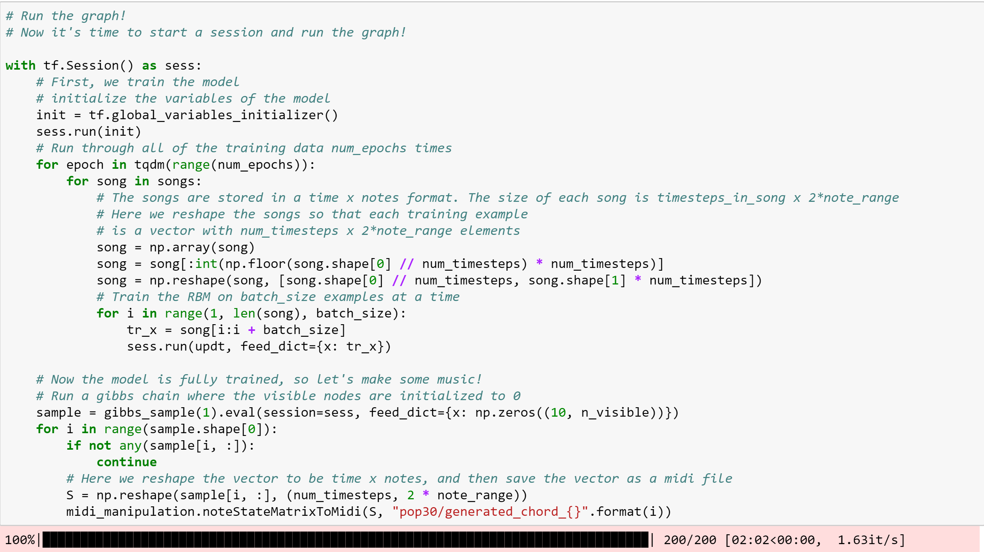
Training the model by using each music file (.midi) as input

Slide 67
References
https://medium.com/@oktaybahceci/generate-music-with-tensorflow-midis-4bf928a35c3a
https://www.reddit.com/r/datasets/comments/3akhxy/the_largest_midi_collection_on_the_internet/
https://www.analyticsvidhya.com/blog/2017/08/audio-voice-processing-deep-learning/
Youtube
https://www.youtube.com/watch?v=pg9apmwf7og&t=721s

Slide 68
Twitter Sentiment Analysis to identify negative feedbacks

Slide 69
Abstract
Twitter - A web application built to find out what is happening at any instance through its micro blogging feature, anywhere
Twitter posts are generally short and generated constantly by public and very well-suited for opinion mining.
Sentiment analysis is the computational treatment of user’s opinions, sentiments and subjectivity of text.

Slide 70
Introduction
Microblog websites play an important role in maintaining social relationships as well as act as a valuable information source
Among several microblogging sites, Twitter is now the most popular, where millions of users spread millions of tweets daily basis
As these tons of tweets reflect people’s opinions and attitudes, sentiment analysis in twitter has made a hit with a lot of complaisance
Monitoring and analyzing tweets sentiment from twitter provide enormous opportunities for the public and private sectors as well as individual users
In this project we collected large number of tweets from twitter using Twitter API for 10 different organizations. We categorized the tweets into positive, negative, or neutral opinion to estimate the overall sentiment of customer or user

Slide 71
Background
Text categorization was started long time ago (Salton and McGill, 1983), however categorization based on sentiment was introduced more recently in 2000
In 2012, Federico Neri Carlo et al. had developed an idea of sentimental analysis using 1000 facebook posts about new casts, comparing the sentiments for the Italian public broadcasting service - towards the emerging and more dynamic private companies
In 2015, Xing fang et al presented an idea of sentiment analysis using product review data which is collected from Amazon.com. His main aim was to tackle the problem of sentiments polarity categorization of sentiments analysis

Slide 72
Approach
Two approaches of Sentiment Analysis
Supervised approaches or machine learning method:
Machine learning is one of the most prominent techniques gaining researchers interest due to its adaptability and accuracy. This method comprises of three stages:
(i) Data collection
(ii) Pre-processing
(iii)Training data Classification.
Unsupervised (or lexicon-based) method:
Lexical analysis estimates the sentiment from the semantic orientation of words or phrases that occur in a text

Slide 73
Dataset
Dataset we are using for the sentiment analysis is tweets we are collecting with the help of Twitter API
StreamListener is a class provided by tweepy to access the Twitter Streaming API
Dataset contains the tweet id, screen name i.e. the name of user, tweet creation date and time, and the text of the tweet
The training dataset for Naïve Bayes classifier is taken from crowdflower where the 9000 tweets are manually analyzed, and sentiments were calculated
For dictionary based approach we use AFINN-111 dictionary which has 2477 words with the polarity score for each word

Slide 74
Methodology
Step 1: Writing Python code which allows us connecting Twitter server to crawl the data using the Twitter API
Step 2: Collecting data from Twitter
Step 3: Data pre-processing
Step 4: Classification
Supervised approaches or machine learning method
Using Naïve Bayes Classifier
Using SVM
Unsupervised approach (or lexicon-based) method

Slide 75
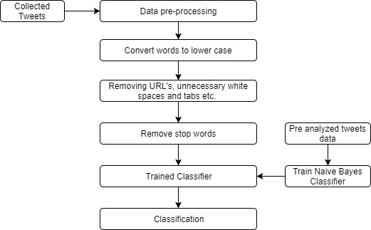
Methodology (Cont’d)
Using Naïve Bayes Classifier:
Train the Naïve Bayes Classifier using the Training data
Read test data i.e. collected tweets and pre-process it
Calculate the sentiment using the trained classifier
Calculating the accuracy of Sentiment Analysis performed by Naive Bayes

Slide 76
Methodology (Cont’d)
Using SVM
Steps for classification till the preprocessing are same as Naïve Bayes
TfidfVectorizer aim to help to convert a collection of text documents to vectors of token counts
When a prior dictionary is not available, TfidfVectorizer can be used as an Estimator to extract the vocabulary, and generates a TfidfVectorizerModel
The model produces sparse representations for the documents over the vocabulary
During the fitting process, TfidfVectorizer will select the top vocab size words ordered by term frequency across the corpus
Obtained feature vectors are used to train the SVC classifier with high regularization parameter value along with rbf kernel
After obtaining the classifier we are applying it to our collected tweets to identify the desired sentiment of the tweet
The sentiment are divided into positive, negative and neutral with scores of 1,-1 and 0 respectively

Slide 77
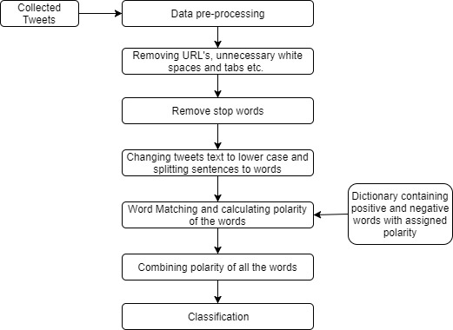
Methodology (Cont’d)
Unsupervised approach (or lexicon-based) method
We used lexical method for classification
This approach depends on finding words from tweets, and then matches the word with the dictionaryical method for classification
The negative words obtained by this approach are more filtered and specific than the Naïve Bayes approach

Slide 78
References
Paramita Ray; Amlan Chakrabarti “Twitter sentiment analysis for product review using lexicon method” 2017 International Conference on Data Management, Analytics and Innovation (ICDMAI) Year: 2017 Pages: 211 – 216
Ajay Deshwal; Sudhir Kumar Sharma “Twitter sentiment analysis using various classification algorithms” 2016 5th International Conference on Reliability, Infocom Technologies and Optimization (Trends and Future Directions) (ICRITO) Year: 2016 Pages: 251 – 257
Umme Aymun Siddiqua; Tanveer Ahsan; Abu Nowshed Chy “Combining a rule-based classifier with weakly supervised learning for twitter sentiment analysis” 2016 International Conference on Innovations in Science, Engineering and Technology (ICISET) Year: 2016 Pages: 1 – 4
Chintan Dedhia; Jyoti Ramteke “Ensemble model for Twitter sentiment analysis” 2017 International Conference on Inventive Systems and Control (ICISC) Year: 2017 Pages: 1 – 5
https://www.crowdflower.com/data-for-everyone/
https://github.com/mmmayo13/tweet-sentiment-scores/
http://www2.imm.dtu.dk/pubdb/views/publication_details.php?id=6010

Slide 79
Speech Recognition: Deep Learning and Existing API Comparison

Slide 80
Inspiration
Siri by Apple Inc.

Slide 81

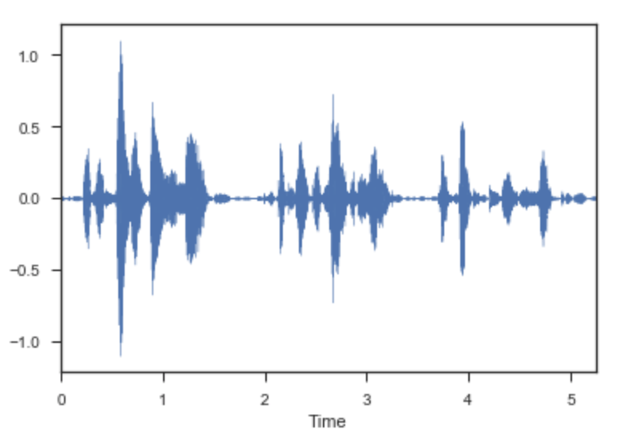
Singals
Continuous signal (analog) -> discrete signal (digital)
Wave plot

Slide 82
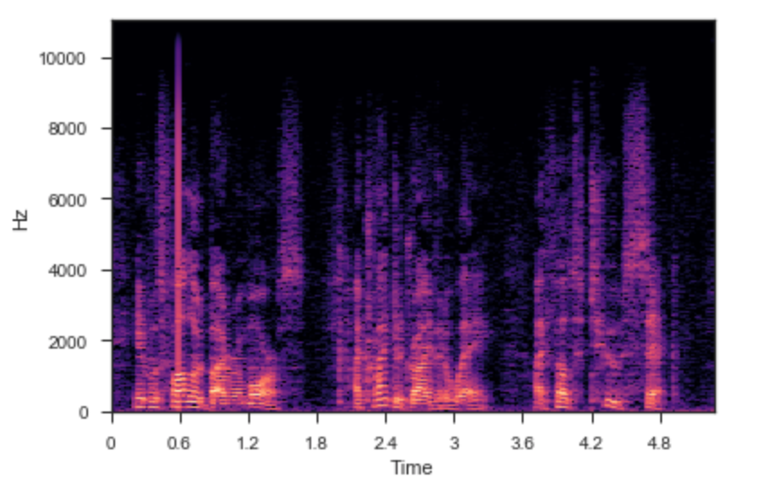
Signals
Continuous signal (analog) -> discrete signal (digital)
Spectrogram

Slide 83
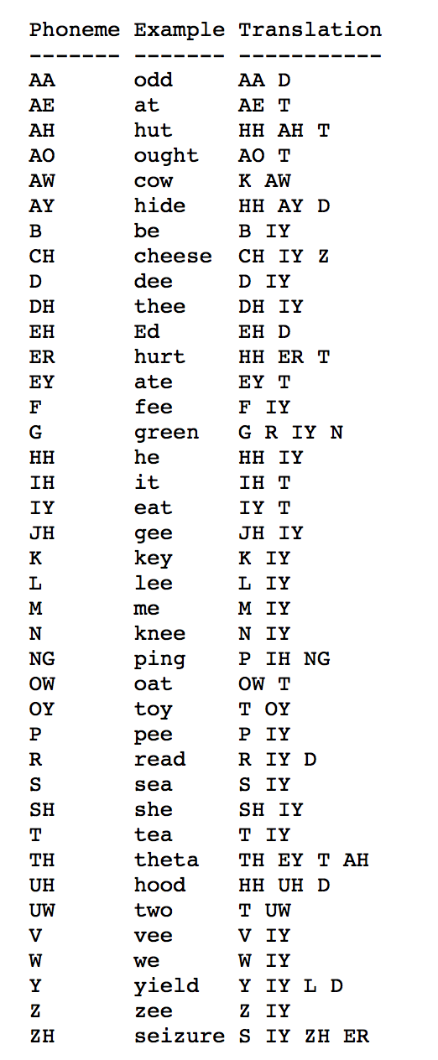
Analysis
Phone (smallest discrete segment of sound)
CMU Sphinx Dictionary (39 syllables)

Slide 84
Recurrent Neural Networks
Convolutional neural networks: order doesn't matter
RNN:
A neural network that has a memory that influences future predictions
Output could be the input next round (notion of repetition)
Order matters, can be used in language analysis and processing

Slide 85
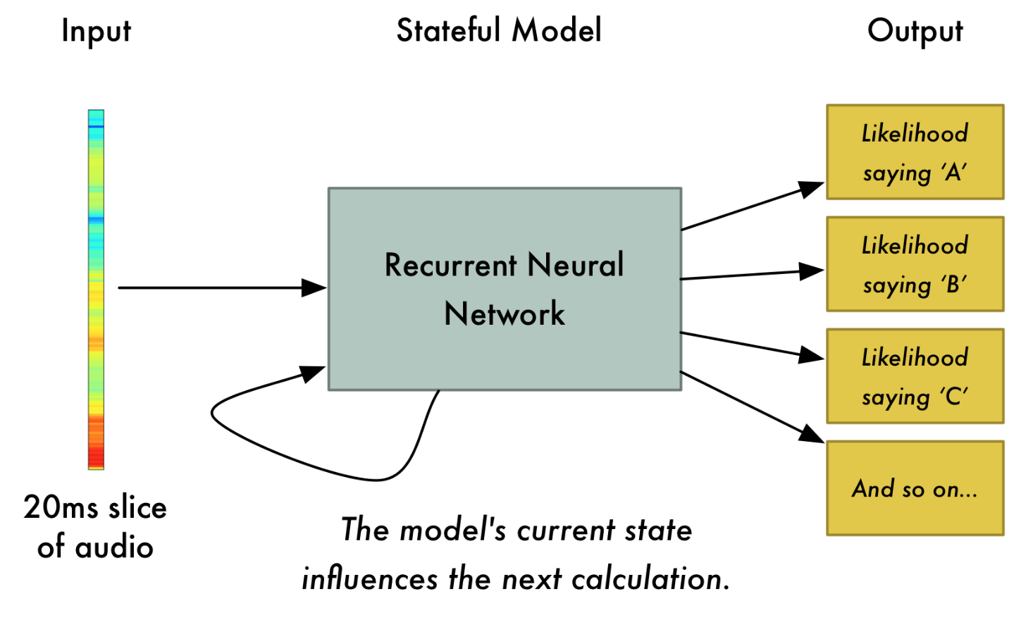
Recurrent Neural Networks

Slide 86
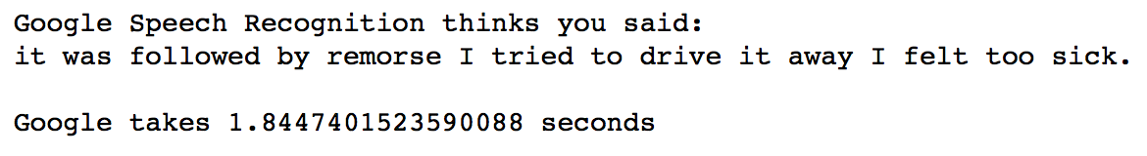
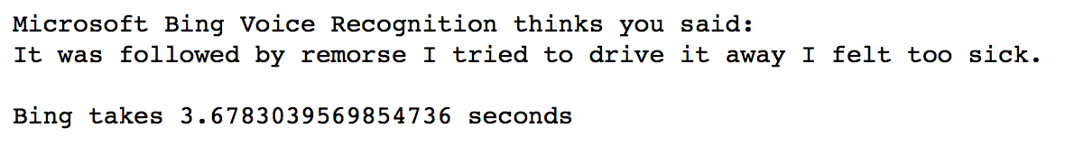
API Outputs

Slide 87
Time Series Analysis of Google Stocks

Slide 88
Topics
Exploratory Data Analysis
Indexing
Stationarity Test of a Time Series
Stationarization of Time Series
Autocorrelation & Partial Correlation
Modelling techniques

Slide 89
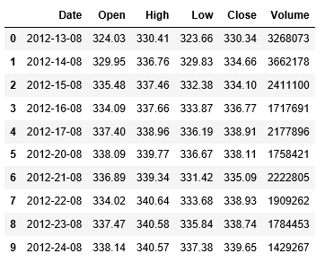
Exploratory Data Analysis
A glimpse of the Google Stock dataset

Slide 90
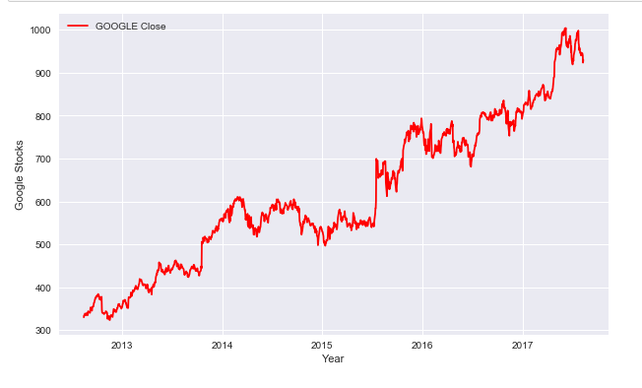
The Closing stocks of Google over the years

Slide 91
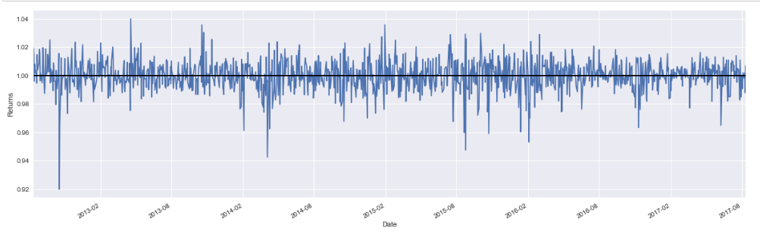
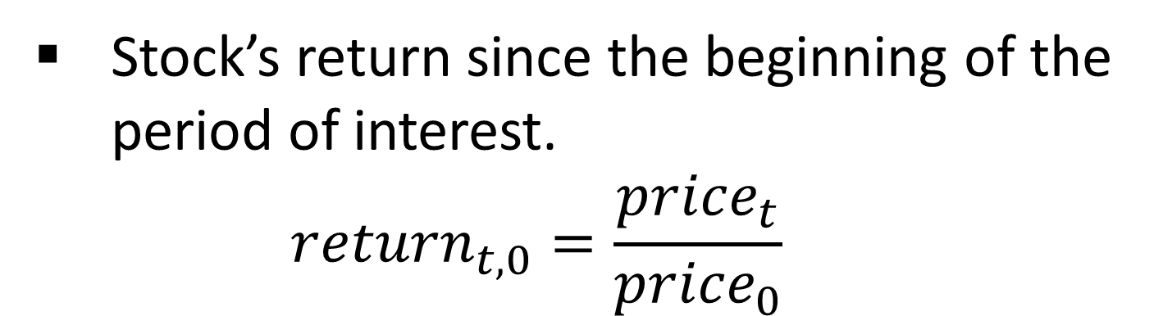
Stock’s return since the beginning of the period of interest. ${return}_{t,0}=\frac{{price}_{t}}{{price}_{0}}$

Slide 92
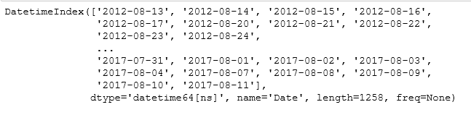
Indexing

Slide 93
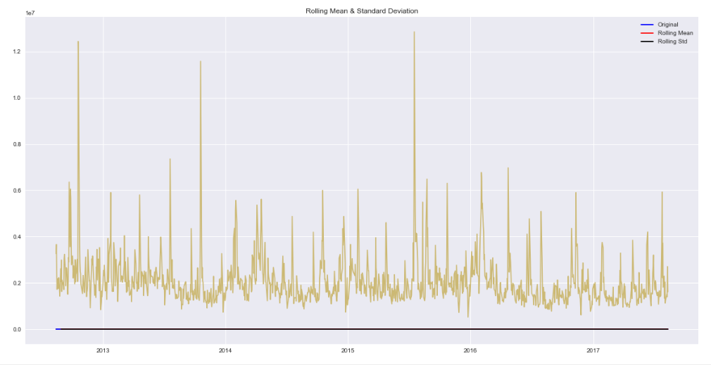
Stationarity Test of a Time Series
Results of Dickey-Fuller Test:
Test Statistic -0.857278
p-value 0.801716
#Lags Used 0.000000
Number of Observations Used 1257.000000
Critical Value (1%) -3.435563
Critical Value (5%) -2.863842
Critical Value (10%) -2.567996 dtype: float64

Slide 94
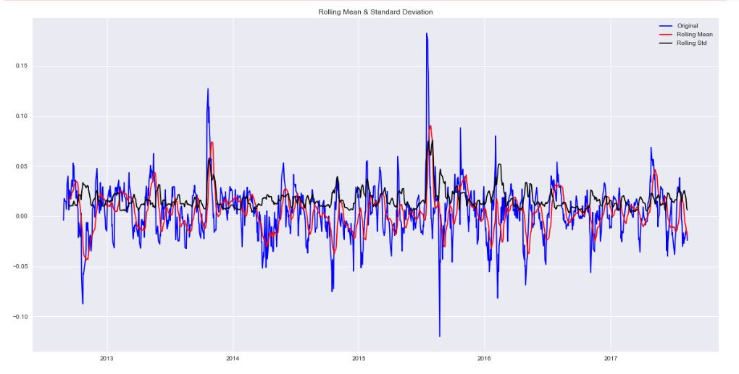
Stationarization of Time Series
Results of Dickey-Fuller Test:
Test Statistic -7.689021e+00
p-value 1.435759e-11
#Lags Used 1.100000e+01
Number of Observations Used 1.235000e+03
Critical Value (1%) -3.435656e+00
Critical Value (5%) -2.863883e+00
Critical Value (10%) -2.568018e+00 dtype: float64

Slide 95


Exponentially Weighted Moving Average
Results of Dickey-Fuller Test:
Test Statistic -6.954230e+00
p-value 9.519708e-10
#Lags Used 0.000000e+00
Number of Observations Used 1.257000e+03 Critical Value (1%) -3.435563e+00
Critical Value (5%) -2.863842e+00
Critical Value (10%) -2.567996e+00 dtype: float64

Slide 96

Differencing Techniques
Results of Dickey-Fuller Test:
Test Statistic -35.230852
p-value 0.000000
#Lags Used 0.000000
Number of Observations Used 1256.000000 Critical Value (1%) -3.435567
Critical Value (5%) -2.863844
Critical Value (10%) -2.567997 dtype: float64

Slide 97

Decomposition

Slide 98

Stationarity Of Residuals
Results of Dickey-Fuller Test:
Test Statistic -9.694016e+00
p-value 1.116803e-16
#Lags Used 2.000000e+01
Number of Observations Used 1.187000e+03 Critical Value (1%) -3.435871e+00
Critical Value (5%) -2.863978e+00
Critical Value (10%) -2.568068e+00 dtype: float64

Slide 99

Autocorrelation

Slide 100
Database Design Process
Requirement colle
Notes:
2

